Slide 1
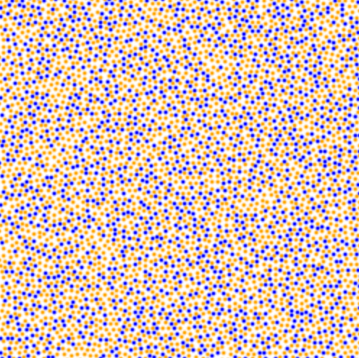
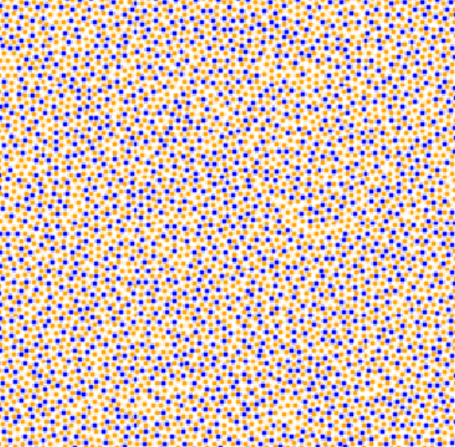
Can a computer distinguish between 2D liquid and glass configurations?
vs
Liquid
Glass

Slide 2
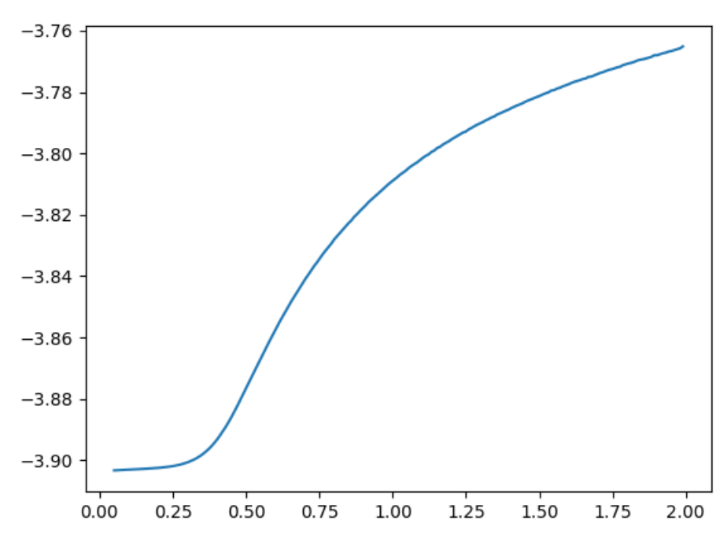
To generate data, we performed 10,000 NVT Kobb-Andersen simulations
Cooling curve
Simulation Details:
10,000 independent NVT Kobb-Andersen mixture simulations of liquid cooling into a glass using cooling rate of 2e7
Total 4320 particles, 65% orange and 35% blue
Atomic configurations saved at 200 different temperatures and rendered as 250 x 250 pixel PNG files
Inherent Structure Energy
Tg
Temperature
Glass
Liquid

Slide 3
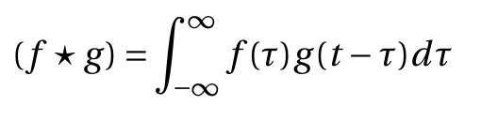
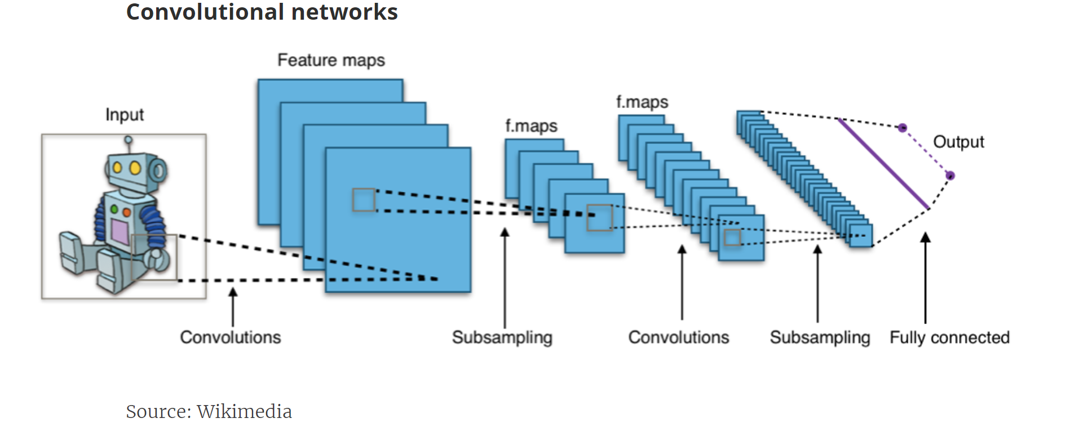
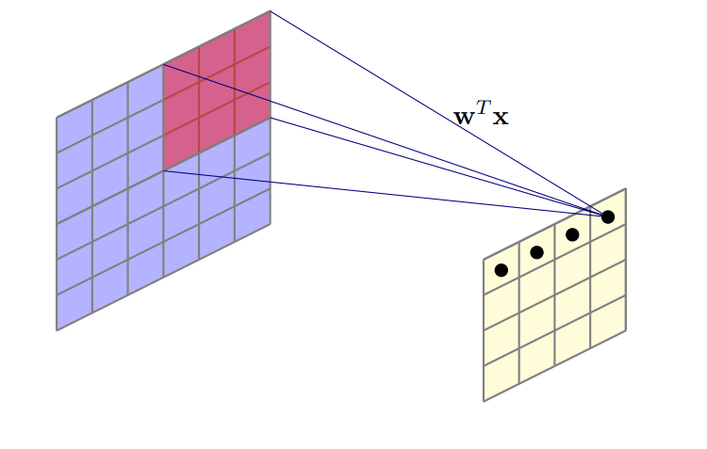
To analyze the data, we used an algorithm that is excellent at image recognition
Convolutional Neural Network (CNN):
Applies convolution transformation:
Convolution is translation invariant, which is critical for image recognition

Slide 4
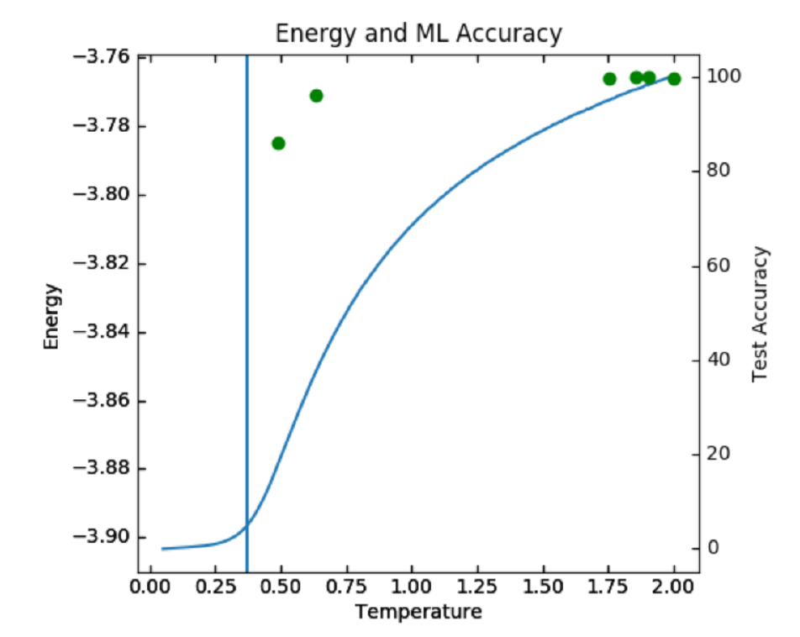
Result: a CNN can classify 2D liquids and glasses with high accuracy
Binary Classification Accuracies
Accuracies + cooling curve plot
Glass Temperature (LJ units) | Liquid Temperature (LJ units) | Classification Accuracy
0.05 | 1.95125 | 99.83%
0.05 | 1.9025 | 99.93%
0.05 | 1.85375 | 99.93%
0.05 | 1.75625 | 99.67%
0.05 | 0.635 | 96.32%
0.05 | 0.48875 | 86.11%
Tg
CNN trained independently at each pair of glass/liquid temperatures
Tg = 0.37 for the cooling curve with cooling rate 2e7
High accuracy attained for liquid temperatures close to Tg = 0.37

Slide 5
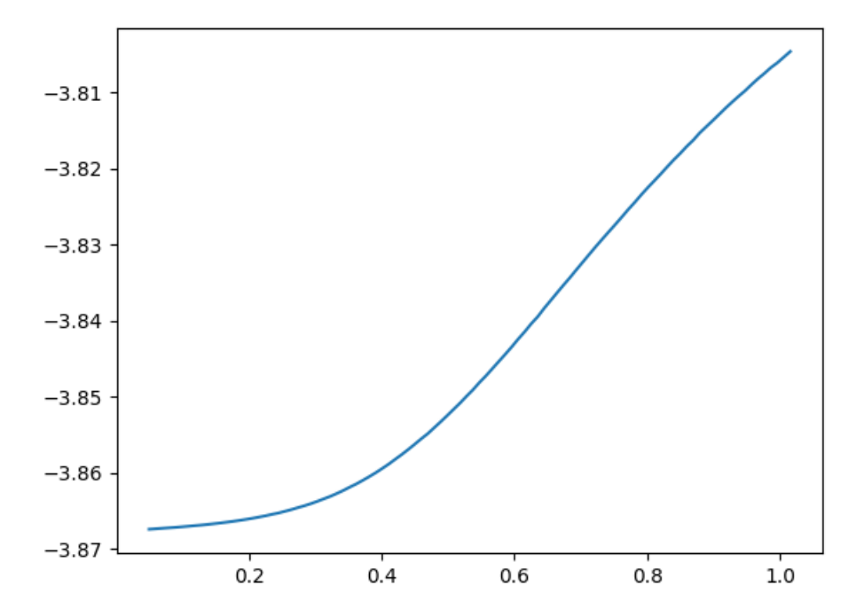
The model can also accurately classify data from a different cooling rate
Cooling rate 2e5
Inherent Structure Energy
Temperature
Tg
10,000 glass images
10,000 liquid images
2e5 Classification Accuracy Using Model Trained on 2e7 Data
Glass Temperature (LJ units) | Liquid Temperature (LJ units) | Classification Accuracy
0.05 | 0.80075 | 89.13%

Slide 6
Moreover, it can classify glasses and supercooled liquids at the same energy
2e7 cooling curve
2e5 cooling curve
Inherent Structure Energy
Inherent Structure Energy
E=-3.86 is a
liquid
E=-3.86 is a glass
Temperature
Temperature
Tg
Tg
Classification Accuracy of Glass versus Supercooled Liquid
Why this is interesting:
This suggests that the CNN is not simply calculating energy
Instead, the CNN may be distinguishing differing geometric structures
Inherent Structure Energy (LJ units) | 2e5 Glass Temperature (LJ units) | 2e7 Liquid Temperature (LJ units) | Classification Accuracy
-3.867 | 0.05 | 0.54725 | 85.20%

Slide 7
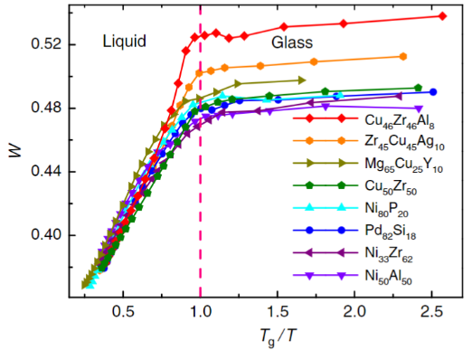

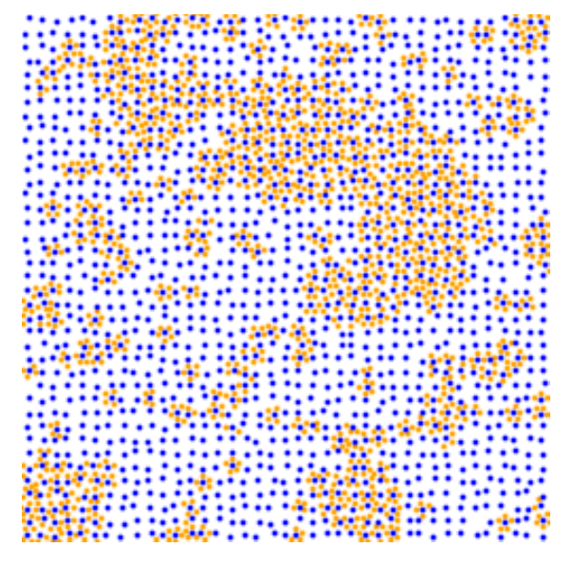
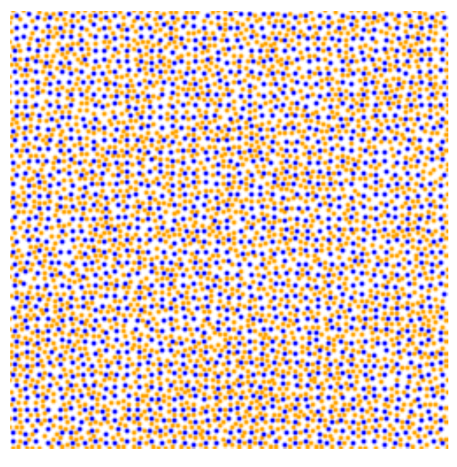
We have not yet been able to analyze the algorithm’s decision process
It is possible that the algorithm is discovering a higher level of five-fold symmetry in glasses relative to liquids
We generated images with artificial five-fold symmetry to test this hypothesis, but the network classified them as liquids
Degree of five-fold symmetry (W) in previous work
[Hu et al. (2011)]
Attempt to generate images with artificial five-fold symmetry

Slide 8
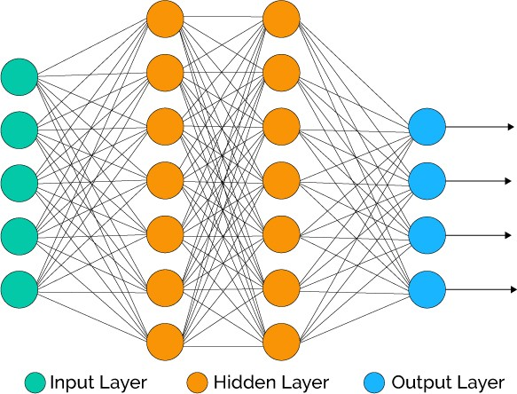
Even without an interpretation, the result is still interesting
From the viewpoint of the CNN, we know nothing about the material other than the configuration of particles
We do not know how any of its thermodynamic properties, or whether there are any interactions between particles
Nevertheless, the CNN is able to take raw structural information, atomic configurations – no dynamical information – and still tell the difference between a glass and a liquid with very high accuracy

Slide 9
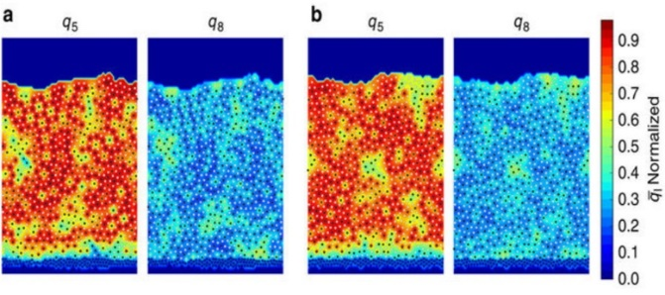
This deep learning tool may be used to solve other difficult classification tasks
Example use case:
Reid et al. (2016)
“The contour map shows no systematic differences in high-order cluster size, location, or shape. We find that the size of the high-order clusters depends only on the energy not the formation method. RDFs and structure factors exhibit no systematic differences…Note, however, that more subtle differences could in principle exist between PVD and liquid-cooled samples.”
Contour maps of five-fold symmetry (q₅) and eight-fold symmetry (q₈) for liquid-cooled (a) and vapor-deposited (b) films at the same inherent structure energy.

Slide 10
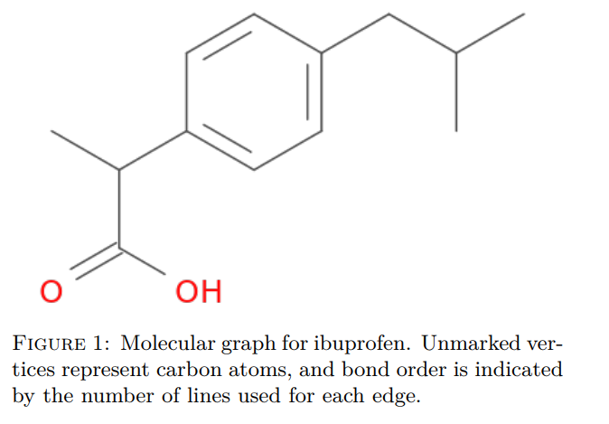
There is also potential for new algorithms to offer a physical interpretation
Graph-based approach (MPNN)
Further work on CNNs may one day show ways to interpret their decision process
The Message Passing Neural Network (MPNN), a graph-based approach, may already be more interpretable
We plan to test MPNN by representing the liquid and glass configurations as graphs
Perhaps, we will see an interpretation like this:
Training to predict chemical properties
MPNN algorithm can identify which graph elements are significant for predictions
MPNN could identify five-fold symmetry as a predictive feature for glassy materials

Slide 11
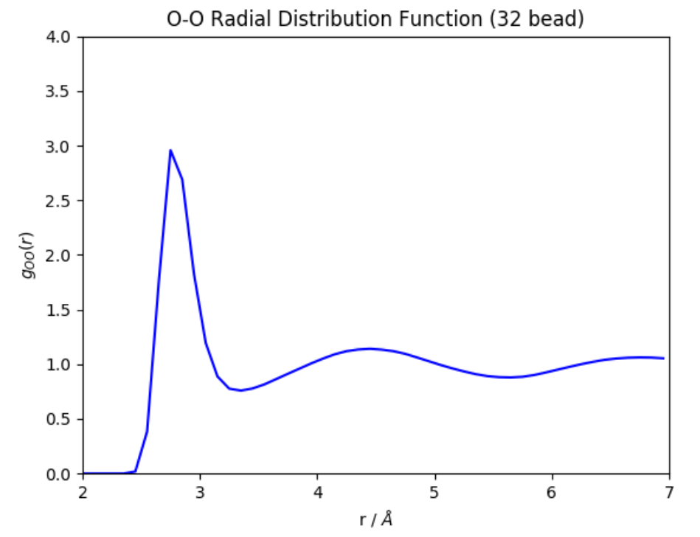
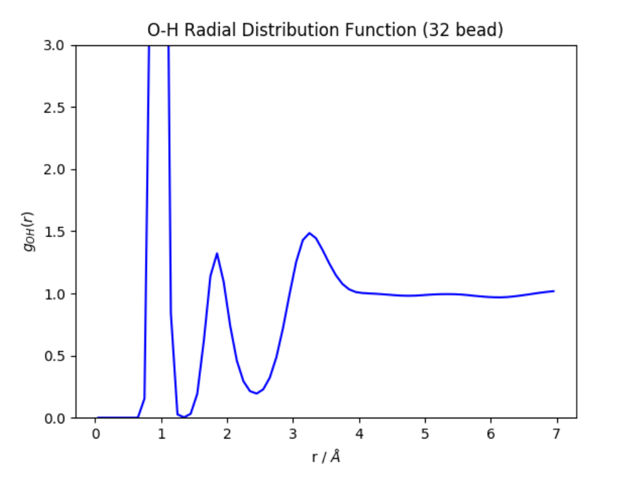
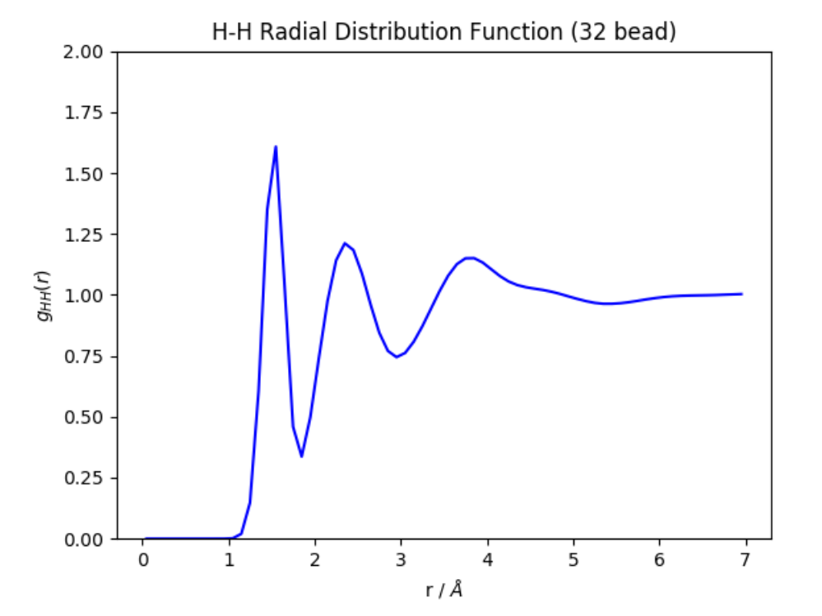
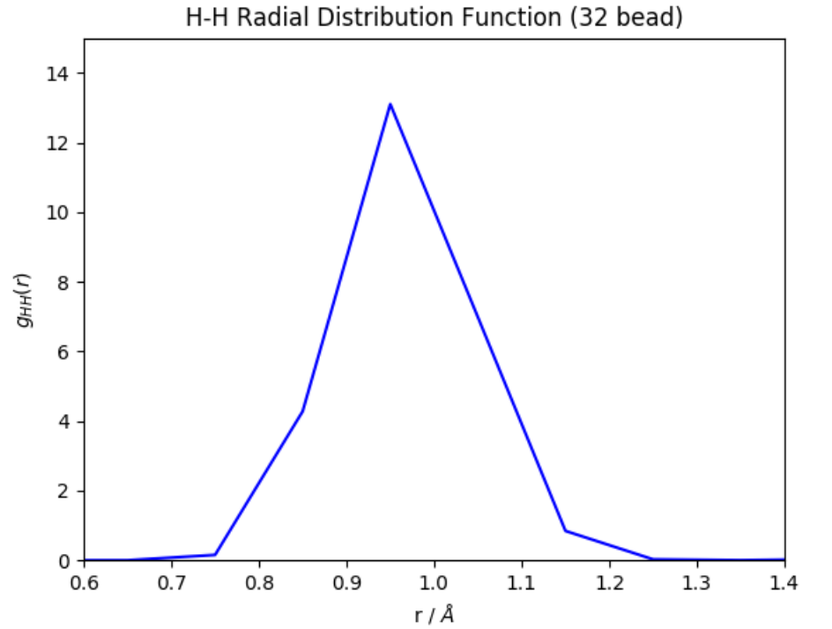
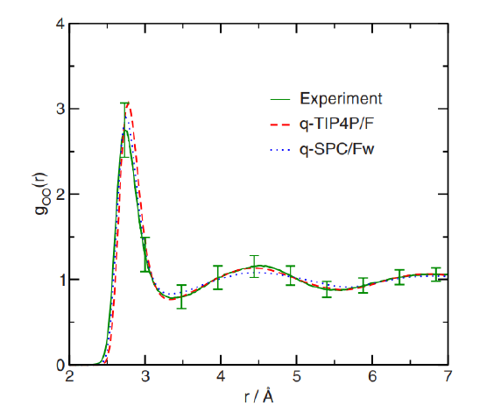
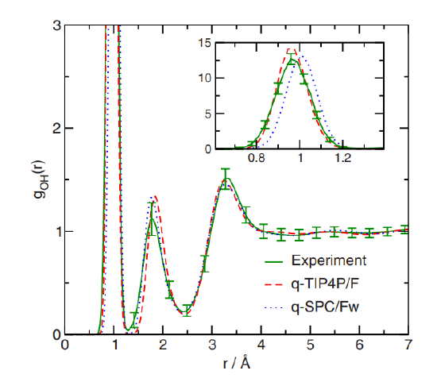
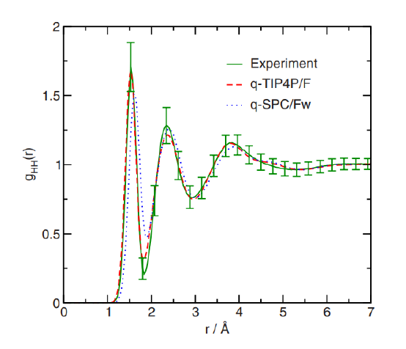
TIP4P/F RDFs using 32 beads are in agreement with the original TIP4P/F paper
Simulation Details:
216 TIP4P/F molecules with an initial density of 0.997 g/ml - NVT Andersen at T = 298 K
100 ps equilibration and 250 ps production - 32 path integral beads
O-O RDF
O-H RDF
H-H RDF
DASH
Markland

Slide 12
TIP4P/F densities using 1 bead are relatively accurate, but we cannot validate using 32 beads without a working path integral barostat
Simulation Details:
3650 TIP4P/F molecules - NPT Berendsen + Andersen at P = 1.0 atm
950 ps equilibration and 50 ps production - 1 path integral bead
Temperature (K) | TIP4P/F Density (g/ml) | NIST Experimental Density (g/ml) | Percent Error (%)
298.15 | 0.98919 | 0.99705 | - 0.788
300 | 0.98771 | 0.99656 | - 0.889
320 | 0.98157 | 0.98943 | - 0.750
In the original paper, TIP4P/F density was parametrized and validated using 32 beads in an NPT ensemble
Currently, DASH does not support constant pressure PIMD, so we do not have a means to appropriately validate TIP4P/F density using 32 beads
A MC barostat compatible with path integrals in DASH is in development but not yet functional

Slide 13
Similarly, TAFFI hexane densities using 1 bead are relatively accurate, but we do not have results for multiple beads
Simulation Details:
500 TAFFI hexane molecules - NPT Berendsen + Andersen at P = 1.0 atm
1950 ps equilibration and 50 ps production - 1 path integral bead
Temperature (K) | TAFFI Hexane Density (g/ml) | NIST Experimental Density (g/ml) | Percent Error (%)
270 | 0.68196 | 0.68025 | + 0.2500
298.15 | 0.65166 | 0.65478 | - 0.4760
320 | 0.62475 | 0.63434 | - 1.5118
RDFs for TAFFI hexane are in progress

Slide 14
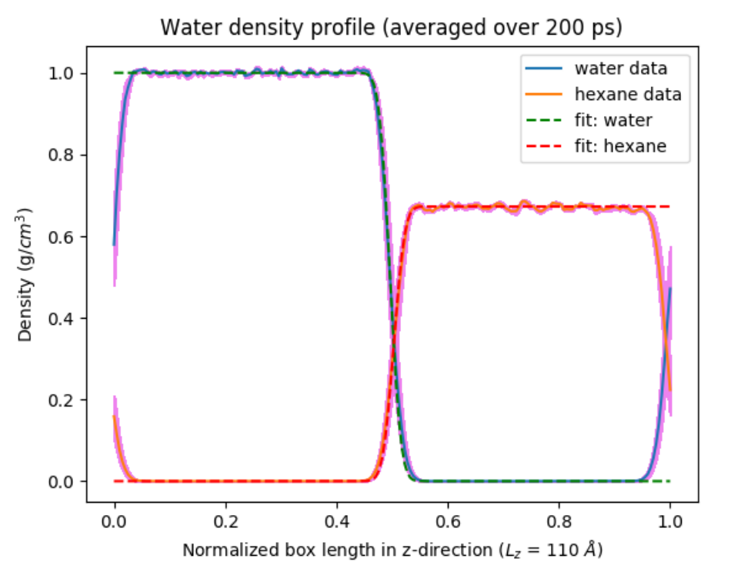
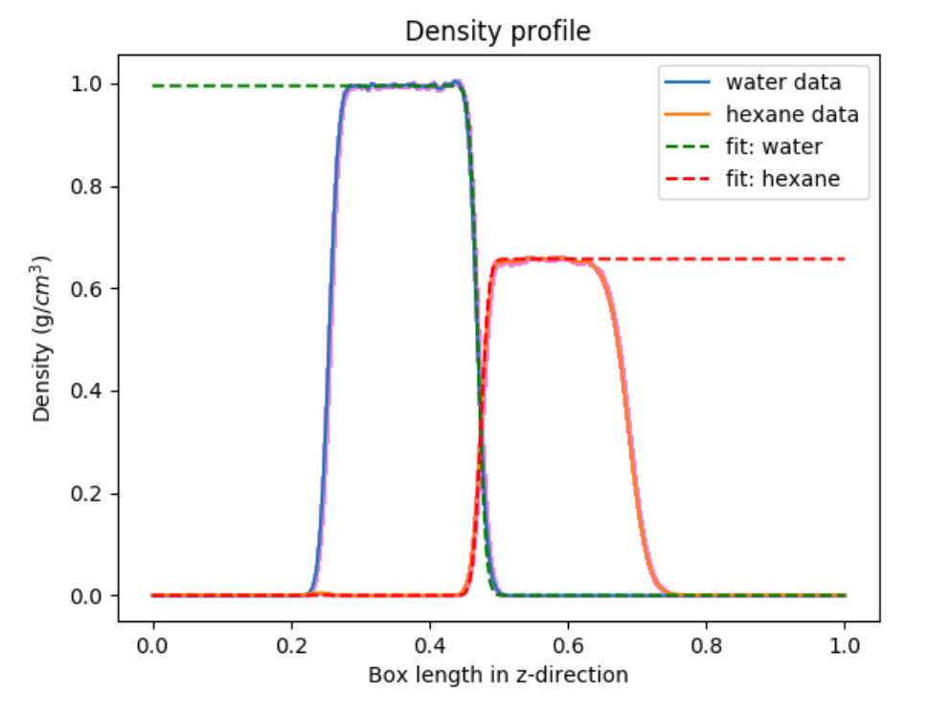
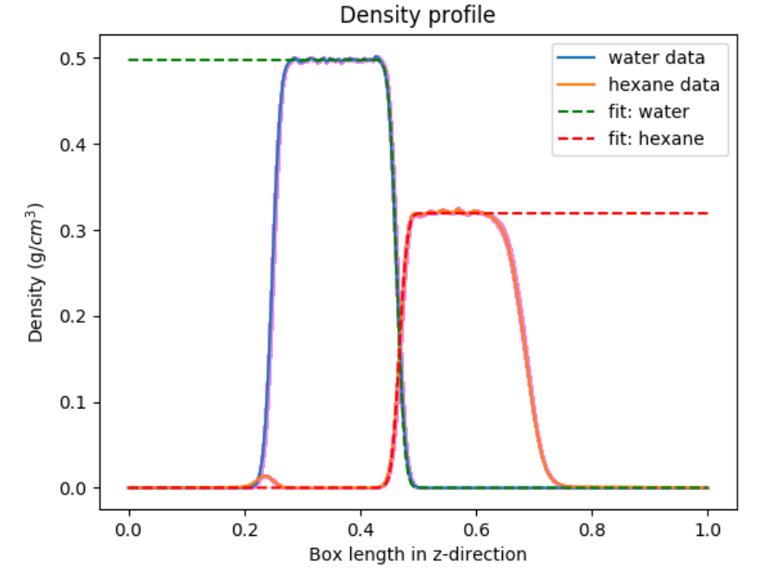
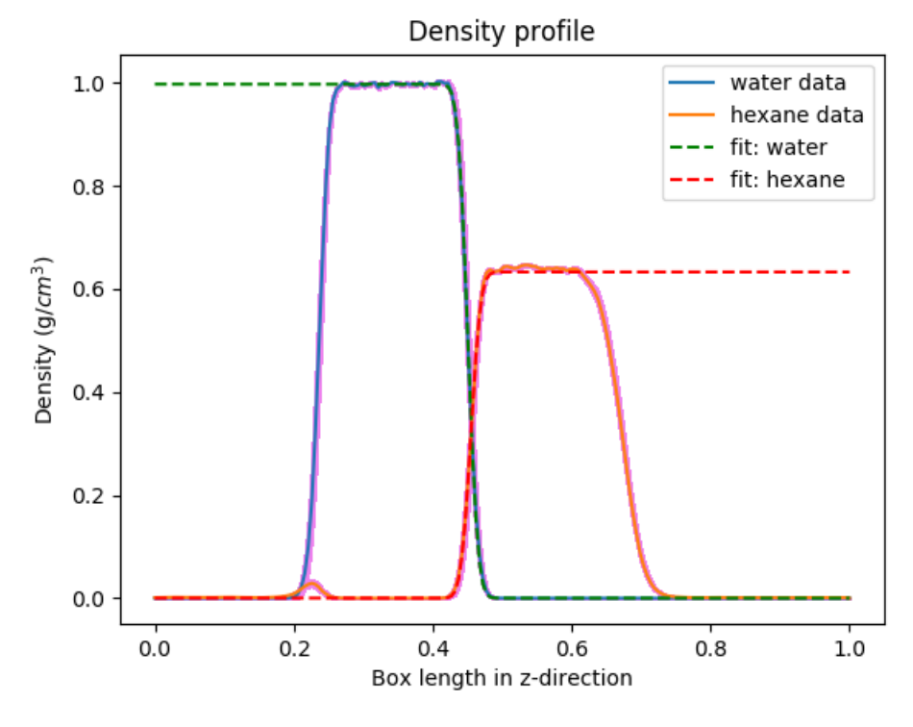
To compute interfacial properties using multiple beads without a barostat, we extended the z-dimension and simulated in the NVT ensemble
1 bead
16 beads
32 beads

Slide 15
Analysis of these simulations shows that nuclear quantum effects might not influence the interfacial width
Simulation Details:
3650 TIP4P/F and 500 TAFFI hexane molecules - NVT Andersen at T = 298.15 K
1 ns equilibration and 2 ns production
Property | DASH 1 Bead | DASH 16 Beads | DASH 32 Beads | Patel and Brooks (2006) | Wick et al. (2012)
Bulk water density (g/ml) | 0.995 | 0.996 | 0.997 | 0.986 | 1.00
Bulk hexane density (g/ml) | 0.657 | 0.639 | 0.633 | 0.684 | 0.65
Intrinsic width (Angstroms) | 0.656 +/- .007 | 0.658 +/- 0.018 | 0.626 +/- 0.022 | 0.366 | 0.498
Average thermal width (Angstroms) | 1.533 +/- 0.047 | 1.567 +/- 0.030 | 1.564 +/- 0.031 | 1.89 | 3.00
Interfacial Tension (mN/m) | 57.29 | In progress | In progress | 43.24 +/- 0.4 | 50.3 +/- 0.8

Slide 16
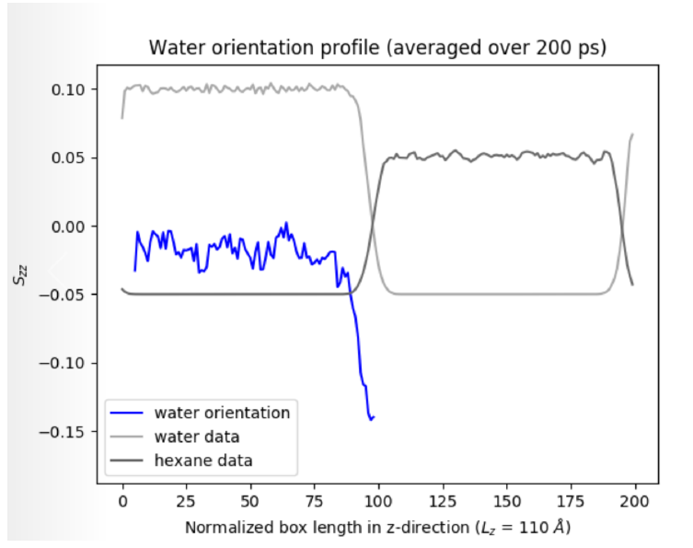
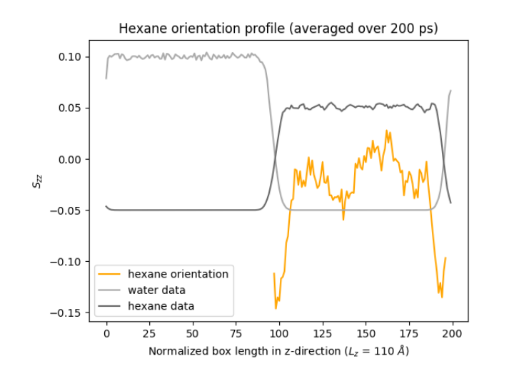
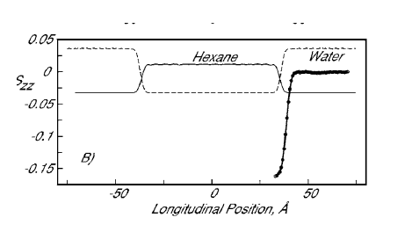
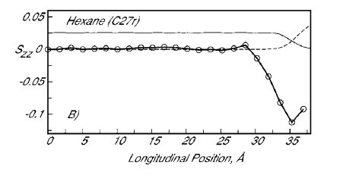
Molecular orientation for 1 bead is comparable to results in the literature, and results for multiple beads are in progress
Simulation Details:
3650 TIP4P/F and 500 TAFFI hexane molecules - NPT Berendsen + Andersen at P = 1.0 atm T = 298.15 K
300 ps equilibration and 200 ps production
Water Orientation
Hexane Orientation
DASH
Patel and Brooks (2006)

Slide 17
Initially we will continue validate force fields and finalize initial analysis of the interface, but we also need to consider new questions
Validation:
Fix RDF calculator to work on depablo node
Compute RDFs for TAFFI hexane
Re-compute RDFs for water using finer bin size
Validate that standard errors are computed rigorously
Compare results from DASH to results from OpenMM code (Markland group, Stanford)
Compare density results using Nose-Hoover barostat
Obtain a working PIMD or PIMC barostat? (Work on this myself)
Initial Analysis:
Compute interfacial tension using multiple beads
Compute molecular orientation using multiple beads
Complete simulations at lower temperatures
Use Elastic bath method (with Kevin van Warkum) to compute pressure in NVT system
Analyze the H-bonding network (e.g. number of H-bonds per molecule at bulk versus interface)
New Questions:
How do nuclear quantum effects impact orientation of heavy versus light water at the hexane-water interface? Is it similar to the water-vapor interface?
Connect PIMD code to E3B model from Skinner
Further Questions?
Read Markland papers
Discuss with Prof. Galli and Prof. Skinner
Water-vapor calculations?

